Slide 1





REVISED RESEARCH DRAFT
Key Escrow in Encrypted Systems
PRESENTED BY
Ali Abubaker
COURSE / DEPARTMENT
UNIVERSITY
Encryption/CS
An-Najah National University
2026-04-15

Slide 2















Background
Confidentiality Strength
The Recovery Paradox
Modern encryption is the cornerstone of data security, ensuring that sensitive information remains protected from unauthorized access.
Strength becomes a vulnerability when keys are lost. Irreversible encryption leads to permanent data loss.
Key Loss: User error, hardware failure, or turnover.
Protects data at rest and in transit.
Corruption: Inaccessible metadata or corrupted key files.
Relies on the availability of cryptographic Keys.
Permanent Loss: No "backdoor" means data is gone forever.
Ensures integrity and privacy for legitimate users.
Confidentiality
Recoverability
"This fundamental tension motivates the need for secure, auditable key recovery and escrow systems."

Slide 3


















The Core Problem
Traditional key escrow systems attempt to solve the recovery paradox but introduce systemic vulnerabilities by concentrating authority.
Centralization Risk
Trust Expansion
High-Value Target
Creates a single point of failure for the entire organization.
Forces users to trust a third-party custodian.
Concentrated authority attracts external attackers.
Expanded trust boundary increases the attack surface.
Breach of central repository exposes all associated keys.
Increases risk of insider abuse or coercion.
Depend On
Targeted By
THOUSANDS OF USERS
SINGLE ESCROW POINT
EXTERNAL/INSIDER THREATS

Slide 4












Aim of the Paper
To address the "Recovery Paradox" through a practical, evaluative model that balances data protection with operational resilience.
Teachable Design
Explicit Trade-offs
Experimental Test
Provide a clear, simple prototype that demonstrates the fundamental logic of dual-control key management.
Make the tension between Recoverability and Trust Concentration visible and manageable.
Empirically test the design against comparison architectures:No Escrow vs. Single Escrow.
"The goal is not to eliminate all risks, but to make them explicit, testable, and manageable."

Slide 5













Main Idea of the Proposed Design
Shifting from centralized trust to a distributed, collaborative, and auditable recovery framework.
Symmetric Encryption
Dual Custody
Explicit Approval
Auditable Logs
Primary data is protected using AES-256-GCM. The Data Encryption Key (DEK) never leaves the client in plaintext.
The Recovery Key (RK) is split into two equal shares. Distributed between independent custodians to prevent unilateral access.
Recovery is not automatic. Requires formal justification and dual sign-off via phishing-resistant MFA (FIDO2).
Every recovery action is recorded in a tamper-evident log. Ensures complete visibility and forensic accountability for all events.
Central Argument
If escrow must exist to prevent data loss, it must be distributed and visible rather than concentrated in one trusted party. This design makes the trade-off between recoverability and trust explicit and testable.

Slide 6















Design Goals
Strong Encryption
Controlled Recovery
No Unilateral Access
Files must remain protected with industry-standard symmetric encryption (AES-256-GCM).
Data restoration is possible only under strictly defined and authorized conditions.
Prevents any single escrow custodian from recovering files without cooperation.
Auditable Trail
Academic Simplicity
Every recovery-related action is recorded in a tamper-evident audit log for accountability.
Design remains simple enough for teaching, implementation, and experimental evaluation.
Focus: Shifting the balance from unilateral power to shared responsibility and visibility.

Slide 7















System Components
Core roles and architectural entities in the dual-control framework.
Client
Storage Server
Custodians (A & B)
Initiates encryption, generates DEK, and manages data access. Key material never leaves the client in plaintext.
A passive repository for encrypted files and wrapped recovery bundles. Has no decryption capability.
Two authorized roles holding one share of the RK each. Requires collaboration and MFA sign-off for recovery.
Approval Mechanism
Audit Log
Formal gatekeeper workflow requiring dual sign-off. Captures justification and identity before key reconstruction.
Tamper-evident, immutable record of all recovery events. Stored in WORM or blockchain-backed systems for full accountability.
"Trust must be distributed, not concentrated."

Slide 8












Key Structure: DEK and RK
Data-Encryption Key (DEK)
ALGORITHM
Primary Cryptographic Barrier
AES-256-GCM
Randomly generated symmetric key used to encrypt plaintext files.
Never stored in plaintext; only active during normal operations.
WRAPPED BY
Recovery Key (RK)
STRENGTH
The Escrow Authority
256-bit Entropy
Share 1: Custodian A
Share 2: Custodian B
Holds 50% of the RK material. Cannot reconstruct key unilaterally.
Holds 50% of the RK material. Requires collaboration for recovery.
Splitting Mechanism: XOR-based or Shamir’s Secret Sharing ensures no single party holds full recovery power.

Slide 9


















Enrollment and Normal Operation
Establishing the secure foundation and daily data access
Phase 1: Enrollment
1. Generation
2. Encryption
3. Wrapping
4. Storage
Client creates random DEK & RK
File protected via AES-256-GCM
DEK is encrypted under RK
Bundle uploaded to the storage server
Normal Operation
Custodial Independence
Under standard conditions, the user maintains full control over their data without requiring external assistance.
No interaction with Custodian A or B required for daily tasks.
Confidentiality remains strictly on the Client side.
Direct Decryption
Privacy is preserved as long as the primary DEK is available.
User uses local key path to access files instantly.
Dual-Control Key Escrow Prototype
Secure Local Execution • Zero Server Knowledge

Slide 10



















WORKFLOW PHASE
Recovery Workflow
A deliberate, collaborative, and auditable event triggered only by necessity.
STEP 01
STEP 02
STEP 03
Trigger Condition
Formal Request
Dual Approval
Initiated only when DEK is lost or inaccessible. No silent or automated recovery paths.
Custodian A submits a request with formal justification. System notifies Custodian B via secure channels.
Both custodians must sign-off using phishing-resistant MFA (FIDO2). Actions are timestamped.
STEP 04
STEP 05
Key Reconstruction
File Restoration
RK is reassembled from 2-of-2 shares. The key exists only in memory for unwrapping.
Wrapped DEK is decrypted, original file restored, and event finalized in the Immutable Audit Log.
TECHNICAL INTEGRITY
PROCEDURAL CONTROL
FULL TRACEABILITY
[ECC-2:2024 Control 2-8-1 Compliant]

Slide 11





















Threat Model & Security Logic
Reducing trust concentration through structural cooperation and visibility.
Server Compromise
Unilateral Recovery
Covert Access
Even with full access, attackers cannot decrypt data.
Prevention of insider abuse by overprivileged individuals.
Ensuring recovery is an organizational event, not a silent act.
Server holds only ciphertext and Wrapped DEK.
One custodian holds only 50% of the RK.
Audit Logs: Immutable records of all actions.
Mandatory Approval Step cannot be bypassed.
Does not possess RK shares.
Real-time anomaly detection via SIEM integration.
CORE ASSUMPTION
PRIMARY CONSTRAINT
OUTCOME
"Honest-but-curious" Custodians
No Collusion
Distributed Trust

Slide 12



















Out of Scope
The design prioritizes the structural trust model of escrow. It is not intended to eliminate all threats or resist high-tier targeted attacks.
Custodian Collusion
Endpoint Compromise
Client-Side Malware
Cooperation between both parties to bypass recovery controls.
Total control of the client OS or unauthorized physical access.
Keyloggers or scrapers capturing keys during local operations.
Physical Coercion
Hardware Extraction
Other External Risks
Duress or legal force applied to all authorized parties.
Forensic extraction of keys from hardware-backed storage.
Broad environmental and organizational vulnerabilities.
The prototype serves as a teachable, evaluative model for structural security governance, not as a hardened production-ready solution.

Slide 13




















Experimental Objective & Architectures
Objective: Evaluate if the Dual-Control model preserves data recoverability while effectively reducing trust concentration.
CONFIDENTIALITY FOCUS
CENTRALIZED RISK
PROPOSED MODEL
No Escrow
Single Escrow
Dual-Control
Maximum data confidentiality.
Distributed recovery material (Shares).
Enables data recovery via single holder.
Zero recoverability after key loss.
Mandatory Approval Workflow.
Unilateral access risk is high.
Baseline for "Security-only" scenarios.
Immutable audit log for accountability.
Single point of compromise/failure.
Trust: DISTRIBUTED | Recovery: CONTROLLED
Trust: MIN | Recovery: NONE
Trust: HIGH | Recovery: FULL
"Testing procedure focused on whether Architecture 3 could block one-party unauthorized recovery while maintaining data integrity."

Slide 14



















Prototype Setup
Implementation Stack
Simulated Environment
Test Parameters
Lightweight Python 3 prototype for reproducibility.
Five distinct roles simulated on a single local machine:
Test Payload: Fixed 512 KiB file for consistent measurement.
Algorithm: AES-256-GCM (Authenticated Symmetric Encryption).
Client
Storage Server
Focus: Structural and architectural trade-offs.
Custodian A
Custodian B
Prioritizes clarity and teaching over production scaling.
Ensures both confidentiality and data integrity.
Approval/Audit Engine
Note: All cryptographic operations were performed in isolation to prevent environmental interference during measurement.

Slide 15














Metrics and Testing Procedure
Experimental framework for evaluating security, performance, and integrity.
Measurement Metrics
Testing Procedure
Performance Times
1
Normal Operation Phase
Standard encryption/decryption cycles for baseline timing.
Encryption/Decryption & Recovery completion.
Storage Overhead
2
Key Loss Simulation
Intentional deletion of the client’s local DEK.
Bytes added by recovery bundle & audit logs.
Decryption Correctness
3
Recovery Execution
Initiating dual-custodian authentication and approval.
Verification of plaintext matching original file.
Security Blocking
4
Validation & Audit Inspection
Verification of logs and blocking of unauthorized attempts.
Prevention of one-party recovery attempts.
Audit Chain Integrity
Validation of tamper-evident log records.
TRIALS: 100 Independent Runs
FILE SIZE: 512 KiB
RELIABILITY: Averages calculated over 100 trials

Slide 16



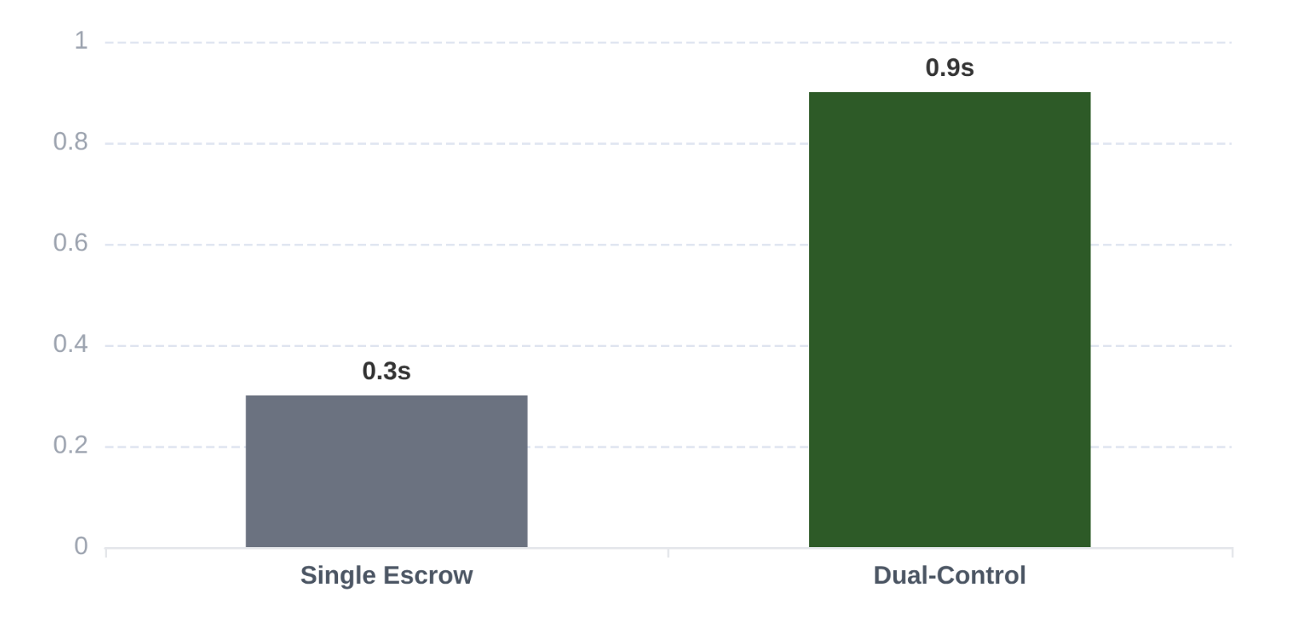
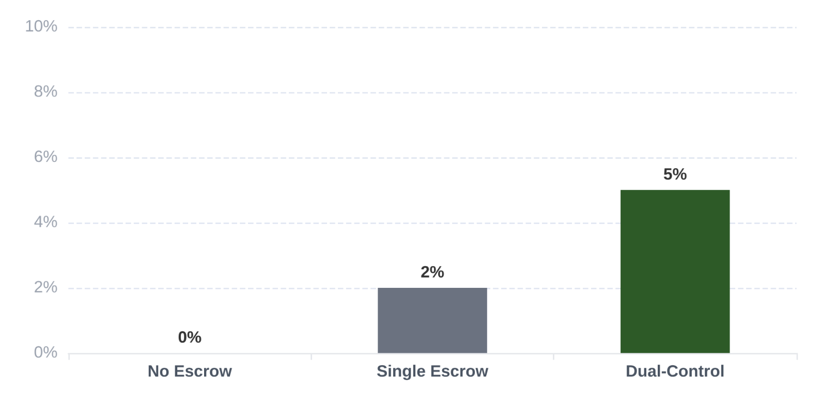



Experimental Results
Performance evaluation of escrow architectures
Average Recovery Completion Time (Seconds)
Storage Overhead (%)
NORMAL OPERATION
RECOVERY LATENCY
STORAGE IMPACT
Encryption and decryption times remained consistent across all architectures with no significant variance.
Dual-control adds ~0.6s over single escrow due to key share reconstruction and audit logging.
Minimal 5% overhead primarily from recovery bundle packaging and audit metadata.

Slide 17








Interpreting the Comparison Tables
Analyzing the fundamental trade-offs between security, recoverability, and cost.
METRIC
NO ESCROW
SINGLE ESCROW
DUAL-CONTROL ESCROW
Recovery Capability
None
Unilateral
Dual Approval
Unilateral Risk
N/A
High Risk
Blocked
Audit Trail
N/A
Partial
Complete
Recovery Time
N/A
0.3 s
0.9 s
Storage Overhead
0%
~2%
~5%
Operational Complexity
Low
Low
Moderate

Slide 18

















Benefits & Practical Usefulness
Transforming escrow from a vulnerability into a structured resilience tool.
Case Study: Nablus Retail
"A family-owned shop in Nablus uses dual-control for financial records, balancing privacy with business continuity."
Why Recoverability Matters
Employee Turnover
Preserve institutional knowledge when key holders leave.
Hardware Failure
Owner
Accountant
Data
SHARE A
RECOVERY
Recovery from corrupted drives or lost local storage.
SHARE B
Forgotten Credentials
Security Outcomes:
Prevent permanent data loss due to human error.
Zero unilateral access to financial records.
Full audit trail for compliance.
Shared responsibility, reduced insider risk.

Slide 19










Risks, Improvements, and Limitations
Evaluating the boundaries of the dual-control prototype
GOVERNANCE RISKS
RECOMMENDATIONS
PROTOTYPE SCOPE
•
Attacker Magnet: Escrow systems become high-value targets for external breaches.
Distributed Recovery: Shift from unilateral to multi-party authority.
01
Teaching Prototype: Designed for evaluation, not high-volume production.
•
Insider Misuse: Potential for authorized users to abuse recovery paths.
02
Explicit Authorization: Require formal dual-approval for all actions.
Local Environment: Measurements conducted on a single machine simulate roles.
•
Coercion: Legal or physical pressure on custodians to bypass controls.
Transparency: Real-time alerting and public (internal) logging.
03
Audit Verifiability: Logs are simple and not yet cryptographically immutable.
•
Governance Failure: Breakdown of organizational procedures and oversight.
Rotating Authority: Periodic updates of custodians to prevent stagnation.
04
Collusion Risk: System cannot technicaly prevent two custodians from conspiring.
Multi-party
Visibility
Audit

Slide 20









Conclusion
Research Summary & Final Recommendations
Key Escrow is a Structural Choice
Key escrow is not inherently a security liability; its value depends on how recovery authority is structured. Distributed designs successfully shift the balance from unilateral power to collective accountability.
Distribute Control
Document Actions
Minimize Scope
Replace single points of failure with multi-party authorization and split knowledge.
Ensure recovery is a visible, auditable event with immutable logging and formal sign-offs.
Limit escrow to essential recovery needs, preventing it from becoming a general-purpose backdoor.
Dual-Control Key Escrow
"Towards a secure, resilient, and accountable cryptographic future."

